Slide 1
Enumeration Types
In Triangle

Slide 2
Overview
Enumeration types are types that allow you to switch variables of their type between the designated “states” that they contain. Enumeration variables and the enumeration states are represented by integers, which makes it easier for the computer to work with them.
Example:
let
var Day : enum { SUNDAY, MONDAY, TUESDAY }
in
begin
Day := SUNDAY;
Day := MONDAY
end
Syntactical Analysis
Contextual Analysis
Run-Time Organization
Code Generation
Interpreter
Disassembler

Slide 3
Specification
Expressions
EnumConstDeclarationList := EnumConstDeclaration
| EnumConstDeclaration, EnumConstDeclarationList
Type Denoters
Type Denoter := enum { EnumConstDeclarationList }
Declarations
EnumConstDeclaration := Identifier

Slide 4
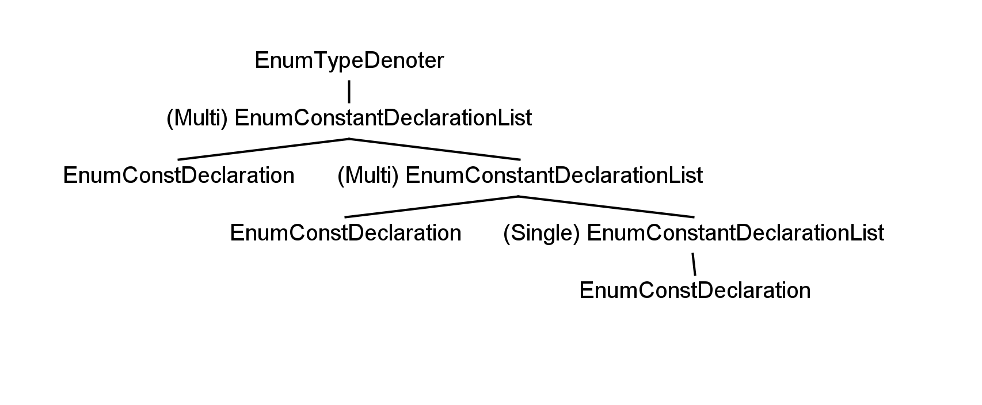
Abstract Syntax Trees
EnumTypeDenoter
EnumConstDeclarList (Abstract)
MultiEnumConstDeclarList
SingleEnumConstDeclarList
EnumConstDeclaration

Slide 5
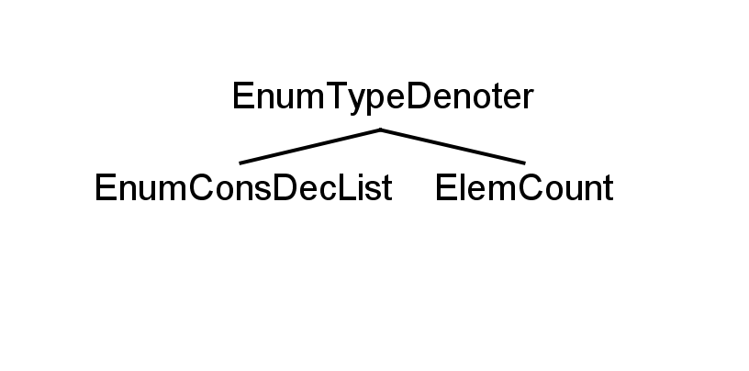
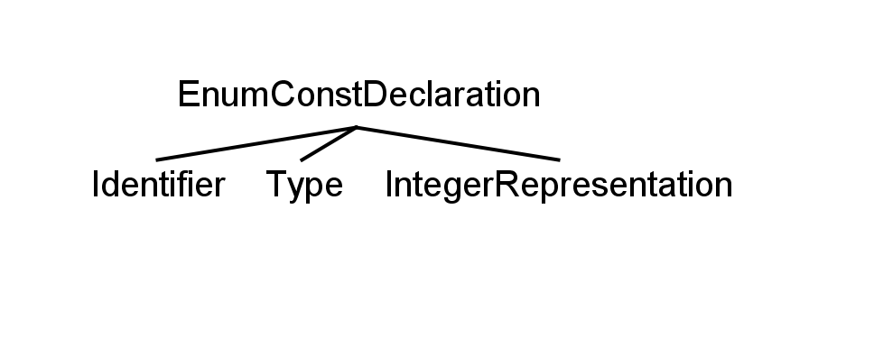
ASTs
EnumConstantDeclarations represent each individual state of the enumeration type.
type Enum1 ~ enum { SUNDAY, MONDAY, TUESDAY }
var Day : Enum1
Identifier = SUNDAY, Type = Enum1, IR = 1
Identifier = MONDAY, Type = Enum1, IR = 2
Identifier = TUESDAY, Type = Enum1, IR = 3
ElemCount = 3

Slide 6
Syntactical Analysis
For the syntactical analysis phase, I implemented proper recognition and parsing of the needed enumeration statements.
A switch case was added to parseTypeDenoter for the enumeration type denoter itself. As the type denoter statement simply contains the enumeration constant declaration list, all that was needed was to accept the ENUM token, parse the declaration list and the opening and closing brackets, and create the new enumTypeDenoter object, sending the result of the list parse to initialize as its specific list. The element count value is initialized at 0 and incremented during contextual analysis.
Parsing the list itself is a bit more complicated, but it was highly modeled after the parseArrayAggregate() method. You can see a comparison of them on the next slide.
Parsing the declaration is simple. It just creates a new enum constant declaration object and sends the result of parseIdentifier to it.

Slide 7
EnumConstDeclarList parseEnumConstDeclarList() throws SyntaxError {
EnumConstDeclarList listAST = null;
SourcePosition listPos = new SourcePosition();
start(listPos);
EnumConstDeclaration ecdAST = parseEnumConstDeclaration();
if (currentToken.kind == Token.COMMA) {
acceptIt();
EnumConstDeclarList ecdlAST = parseEnumConstDeclarList();
finish(listPos);
listAST = new MultiEnumConstDeclarList(ecdAST, ecdlAST, listPos);
} else {
finish(listPos);
listAST = new SingleEnumConstDeclarList(ecdAST, listPos);
}
return listAST;
}
ArrayAggregate parseArrayAggregate() throws SyntaxError {
ArrayAggregate aggregateAST = null;
SourcePosition aggregatePos = new SourcePosition();
start(aggregatePos);
Expression eAST = parseExpression();
if (currentToken.kind == Token.COMMA) {
acceptIt();
ArrayAggregate aAST = parseArrayAggregate();
finish(aggregatePos);
aggregateAST = new MultipleArrayAggregate(eAST, aAST, aggregatePos);
} else {
finish(aggregatePos);
aggregateAST = new SingleArrayAggregate(eAST, aggregatePos);
}
return aggregateAST;
}

Slide 8
Rationale
Initially, I intended to implement the enum type denoter with an array aggregate, which is a list of expressions, rather than the newly created EnumConstDeclarationList. This seemed like a wiser option to save time in creating a new AST for my purpose when the enumeration type basically just uses a list of identifiers, which are expressions. However, this proved ineffective when it was revealed that for type checking there would need to be some way to link each identifier to the specific enumeration type it belonged to. Since identifiers are too simple for this, I needed a new type…the enumConstDeclaration. This new type contained the identifier, a link back to the type, and even made integer representation easier by simply adding the correct integer to each one. So, the new enumConstDeclarationList was created to contain the list of these enumConstDeclarations.

Slide 9
Contextual Analysis
The first step in contextual analysis, was to add the enumeration constant declaration identifiers into the IDTable so that they could be referenced later when you are assigning them into an enumeration variable of their type. As the checker implements the visitor method, this was done simply by having a visit to the type denoter call the visit method of its list, which in turn calls the visitor method of each enumeration constant declaration within it. It is there that the Identifiers for each one are added to the ID Table. This ensures that every object in the AST is visited and fully implements the abstract visitor class.

Slide 10
Contextual Analysis
For the contextual analysis phase, I also implemented type checking for enumeration types. This uses the type denoter fields within each enumeration constant to check if assignment statements are assigning constants of the correct types to the enumeration variables.
For example:
var Day : enum { SUNDAY, MONDAY, TUESDAY }
var Month : enum { JANUARY, FEBRURARY, MARCH }
Day := MARCH
Day := TUESDAY
In the stated Triangle example above, an error will be produced when there is an attempted assignment of a month constant to the day variable, because it is of a different enumeration type. Assigning TUESDAY to Day will work because it is in the correct enumeration type declaration.

Slide 11
Implementation
This was done by checking if visited variables have identifier bindings that are instances of enumeration constant declarations. If they are, then the variable’s type is set to the type that is specified in the constant declaration object. Of course, this itself must be set during the visitation of the initial type denoter declaration.
This is done by having the enum type denoter, when visited, pass itself to its list when it calls the visit method for the list. The list then propagates the object to all the constant declarations within it and there the object is cast into a type denoter and set as the constant declaration’s type field.
Since the object is already being passed, it is also here in the constant declaration visit method that I increment its elemCount by one every time a constant declaration is visited. I also set the integer representations of the enum constant declarations equal to the current elemCount in the EnumTypeDenoter object, which ensures they are given proper incremental integer assignments for them to be represented as.

Slide 12
Contextual Analysis
A further step in contextual analysis was to add proper type checking for the assignment of integers and integer variables to enumeration variables.
For example:
var Day : enum { SUNDAY, MONDAY, TUESDAY }
var num : Integer
Day := 2
num := 3
Day := num
To do this, I allowed all integer expressions on the RHS to pass without error aside from simple integers that were out of range of the enumeration type. Integer variables are checked for range bounds within the TAM later.

Slide 13
AssignCommand Extension
The allowing of integers and integer variables to be assigned to enumeration variables seemed sensible as you would want to increment states by a certain amount or set the state of something equal to what a variable is currently at in order to make full use of the potential that enumerations provide. However, this proved no easy task. The visitAssignCommand method had to be extended quite a bit. It now must check if the variable type is an instance of an enumTypeDenoter and then apply special rules for them. The expression is then checked to see if it is an IntegerType. This is done by visiting the expression, as by default doing this in the checker already returns the type. Of course, in the case where it is found to be an integer type then the default failure check of if the expression is equal to the type of the variable is bypassed. Integers and variable integers would never be equal to an enumeration type.
Another check is then made to see if the Expression is an instance of a Vname Expression or an Integer expression. If it is a v-name expression, then the assigncommand simply returns null. All integer variables are allowed to pass the assigncheck because assigning an integer is allowed and there is no way to check if a variable falls within range of the enumeration type until interpretation. If it is not a v-name, then it must be an integer expression and this integer is checked to see if it is within the range of the elemcount in the enumtypedenoter object. If it isn’t, an error is produced, otherwise null is returned.

Slide 14
Run-Time Organization
Enumeration constant declarations simply had to be set to be treated as integers in the Encoder. This was easily done as I already set the proper integer for each enum constant declaration in their respective integer representation fields during contextual analysis. This was done when visiting the constant declaration:
ast.entity = new KnownValue(Machine.integerSize, ast.IR);
writeTableDetails(ast);

Slide 15
Code Generation
For code generation, I had to set the enumeration type denoter size as equal to Machine.IntegerSize. This is because an enumeration variable only takes up the space of one state (which is an integer) at a time. Only one state is active at any given time. This is contrary to arrays which take up the space of every item within.
ast.entity = new TypeRepresentation(Machine.integerSize);
For the assigned command, I implemented a special case where if the LHS was an enumeration variable then after the RHS is evaluated, the value is checked to see if it is within the enumeration type range before the value is assigned to the LHS. I did this check with an extension to the TAM that is a new op code. Although the call to check the variable is in the encoder, the actual check is not done until the program is ran during interpretation.

Slide 16
Code Templates
All the visit methods also manage the proper creation of new frames that are needed and result in the generation of the correct stack commands. These have been verified with the disassembler.
elaborate [ type Day ~ enum { E1, E2, ..., En} ]
no code
elaborate [ var DayVar : Day]
PUSH 1
execute [ DayVar := E3 ]
LOADL 3
STORE (1) 0[SB]

Slide 17
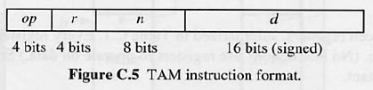
Interpreter
For the interpreter, I had to add a new op type that allowed me to call a check command to see if integer variables that are being assigned to enumeration variables are within the range of states that the enumeration type contains. The call for this is done in the encoder’s visitAssignCommand between the visitation of E and the call to the emitStore method:
if (vType instanceof EnumTypeDenoter) {
EnumTypeDenoter enumType = (EnumTypeDenoter) vType;
emit(Machine.CHECKop, 0, 0, enumType.elemCount); }
As you can see, I added the new CHECKop constant inside the Machine class to represent this new command. The TAM instruction format allows for three variables to be passed: r, n, and d. I sent 0 for both r and n then used d for the value needed. d is simply the amount of elements in the enumeration type the variable is being checked for compatibility with.
execute [ DayVar := intVar ]
LOAD intVar
CHECK RANGE
STORE DayVar

Slide 18
Interpreter
The CHECKop was then implemented in the interpreter to compare the elemcount value with the variable value stored in the stack top of the frame:
case Machine.CHECKop:
int dataValue = data[ST-1];
if (dataValue < 1 || dataValue > d) {
status = failedEnumRange; }
CP = CP + 1;
break;
failedEnumRange is a new fail state that displays an error message
indicating the variable was out of range.

Slide 19
Disassembler
For the disassembler, I simply had to add the new switch case for the check op that output the proper status message. The full stack command from the disassembler can be seen below:
********** TAM Disassembler (Sun Version 2.1) **********
0: PUSH 1 // Pushes one space on the stack to elaborate the enum var.
1: PUSH 1 // Pushes one space on the stack for the integer variable.
2: LOADL 3 // Loads the literal 3.
3: STORE (1) 1[SB] // Stores the 3 into the integer variable.
4: LOAD (1) 1[SB] // Loads the 3 from the integer variable for the enum assignment.
5: CHECK ENUM RANGE // Checks to see if 3 is within the enumeration type’s range.
6: STORE (1) 0[SB] // If it is, this value is now set for the enum variable.

Slide 20
Conclusion
Enumeration types have been fully implemented in all phases within my Triangle compiler. While they can be used and are allowed some freedom with the assignment of integers and integer variables to the enumeration variables, there are still more advanced features they could be enhanced with that are already implemented in other languages, such as enumeration methods in Java. Although my implementation of enumeration types is not as extensive as that, it offers the main core function of enumeration types to be utilized in Triangle. It was a difficult task to modify the Triangle compiler to allow for enumeration types, but I now feel I have a good understanding of how the compiler works in most stages and areas of code.

